Slide 1
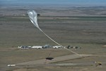
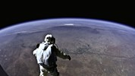
Thermodynamics Design Lab
Design Laboratory Assignment: Atmospheric Satellites Assigned: 19 September 2017 Due: 3 October, Prelab report on balloon scale model results
Due: 16 October, All Presentations due 11:59 PM
Red Bull Stratos Launch Vehicle and Limb of the Earth’s Atmosphere Viewed by Felix Baumgartner from an Altitude of 37 km (~120,000 feet)
http://www.redbullstratos.com/
http://www.rt.com/news/199136-eustace-stratosphere-jump-record/
http://www.bigelowaerospace.com/beam/
http://www.google.com/loon/

Slide 2
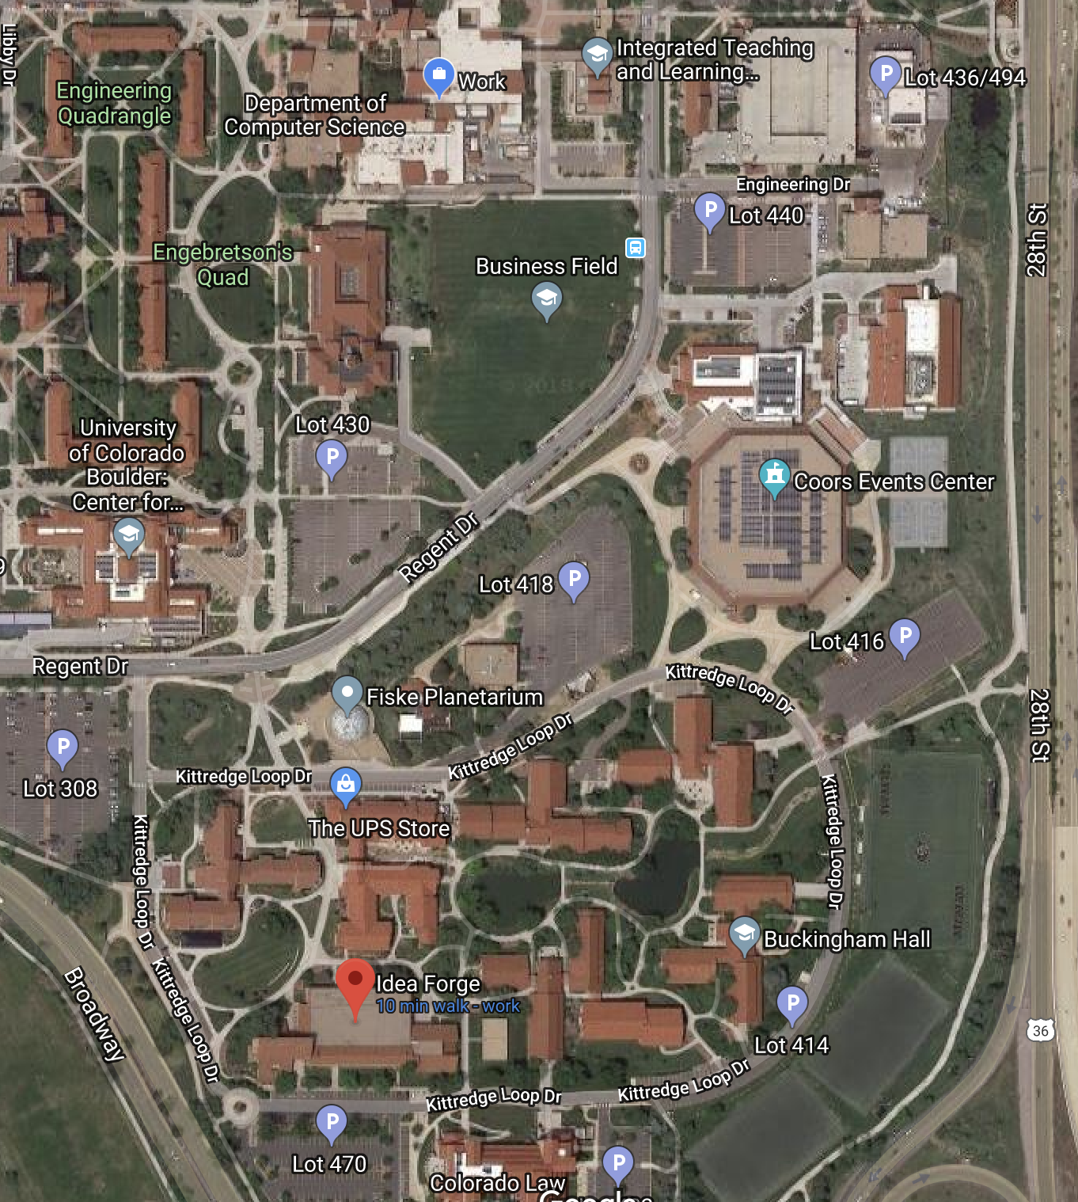
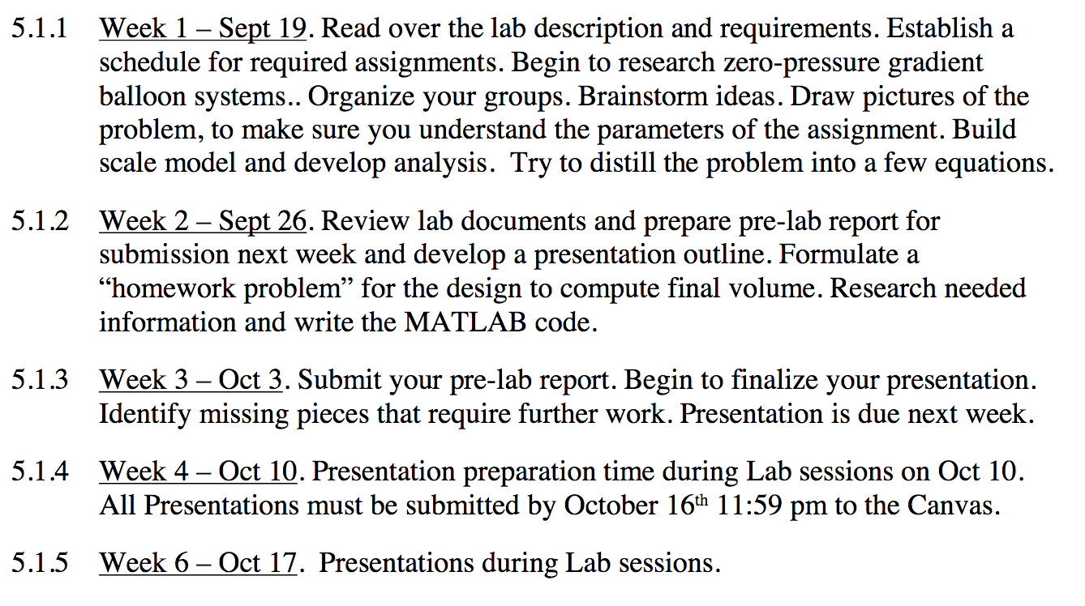
Schedule
Week 1: Prelab. Begin design
Week 2: Finish Pre-lab. Continue design
Week 3: Submit pre-lab. Finalize design
Week 4: Finish design presentation
Week 5: Presentations
ITLL and Idea Forge
UPDATE WITH PICTURE FROM ASSIGNMENT

Slide 3
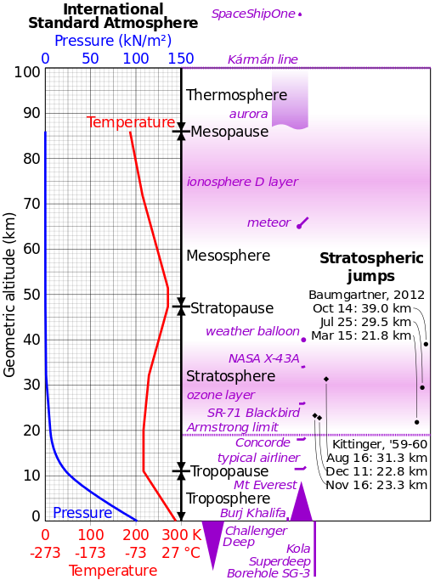
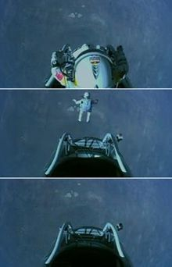
Red Bull Stratos
Red_Bull_Stratos

Slide 4
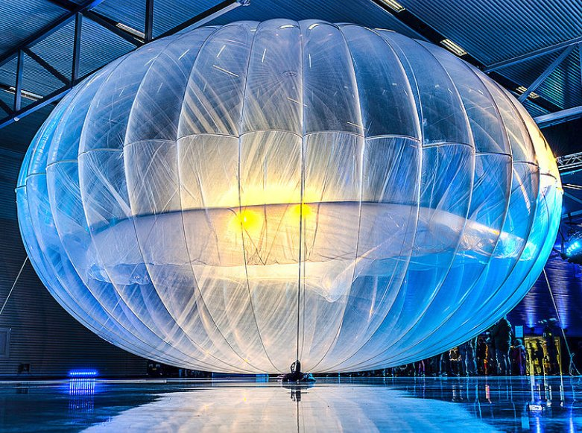
Google’s Project Loon – Atmosphere Satellites
On 16 June 2013, Google began a pilot experiment in New Zealand where about 30 balloons were launched in coordination with the Civil Aviation Authority from the Tekapo area in the South Island. About 50 local users in and around Christchurch and the Canterbury Region tested connections to the aerial network using special antennas. After this initial trial, Google plans on sending up 300 balloons around the world at the 40th parallel south that would provide coverage to New Zealand, Australia, Chile, and Argentina. Google hopes to eventually have thousands of balloons flying in the stratosphere.
In May 2014 Astro Teller announced that rather than negotiate a section of bandwidth that was free for them worldwide they would instead become a temporary base station that could be leased by the mobile operators of the country it was crossing over.
In May-June 2014 Google tested its balloon-powered internet access venture in Piauí, Brazil, marking its first LTE experiments and launch near the equator.

Slide 5
Thermodynamics Design Pre-Lab
1.3 Scale Model Balloon System
Prior to developing a design for a high-altitude balloon system, your task is to build a scale model of a zero-pressure balloon and develop a mechanical and thermal assessment of the system.
1.4 Design a High-Altitude Balloon
In your groups, perform a design analysis of a high-altitude balloon for carrying a research payload.
Your design requirements are as follows:
1.4.1 Payload. A 500 kg research instrument.
1.4.2 Altitude. The balloon should be able to reach an altitude of 35 km
1.4.3 Duration. The balloon should be able to stay in residence for at least one day.
Assumptions:
1.4.4 Shape. Assume the shape of the balloon at target altitude is a sphere
1.4.5 Transients. Ignore transient effects during ascent
1.4.6 Stresses. Ignore stresses on balloon material associated with attaching the payload or wind loading

Slide 6
Buoyant force: The upward force a fluid exerts on a body immersed in it. The buoyant force is caused by the increase of pressure with depth in a fluid.
The buoyant force acting on the plate is equal to the weight of the liquid displaced by the plate.
For a fluid with constant density, the buoyant force is independent of the distance of the body from the free surface.
It is also independent of the density of the solid body.
A flat plate of uniform thickness h submerged in a liquid parallel to the free surface.

Slide 7
The buoyant forces acting on a solid body submerged in a fluid and on a fluid body of the same shape at the same depth are identical. The buoyant force F_{B} acts upward through the centroid C of the displaced volume and is equal in magnitude to the weight W of the displaced fluid, but is opposite in direction. For a solid of uniform density, its weight W_{s} also acts through the centroid, but its magnitude is not necessarily equal to that of the fluid it displaces. (Here W_{s} > W and thus W_{s} > F_{B}; this solid body would sink.)
Archimedes’ principle: The buoyant force acting on a body immersed in a fluid is equal to the weight of the fluid displaced by the body, and it acts upward through the centroid of the displaced volume.

Slide 8
For floating bodies, the weight of the entire body must be equal to the
buoyant force, which is the weight of the fluid whose volume is equal to the
volume of the submerged portion of the floating body:
A solid body dropped into a fluid will sink, float, or remain at rest at any point in the fluid, depending on its average density relative to the density of the fluid.

Slide 9
The altitude of a hot air balloon is controlled by the temperature difference between the air inside and outside the balloon, since warm air is less dense than cold air. When the balloon is neither rising nor falling, the upward buoyant force exactly balances the downward weight.

Slide 10
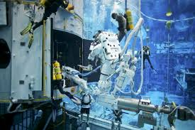
Design a Neutrally Buoyant Balloon System
Archimede’s Principle: The buoyant force of an immersed object equals the weight of the fluid displaced by the object
Neutral Buoyancy = Force Balance
Reduce the force balance equation to one extensive variable, Volume of the balloon, because this is what you want to find and other intensive properties can be looked up without requiring knowledge of the system extent.
NASA Neutral Buoyancy Lab

Slide 11
Thin-Walled Pressure Vessel
Two assumptions that apply to a thin-walled pressure vessel
Thickness of the wall is much less than its radius
The normal stress is exerted uniformly throughout the vessel walls.
where P_{g} is the gage pressure
The ultimate stress of the material (which is a property of a material at which the material fails) given symbolically as σ_{u} is related to the normal stress by a factor, k, often termed the factor of safety

Slide 12
Design Lab Analysis
The thinned-wall pressure vessel assumption leads to an expression for the thickness that depends on factor of safety, balloon radius, gage pressure and ultimate stress
For the lab assume a gage pressure of 10 pascals,
Let the factor of safety be a variable by which you determine and justify in your presentation
Select a balloon material to find its material density and ultimate stress
Solve for the balloon volume (or equivalently the balloon radius) based on the design requirements
Resources:
NASA Long Duration Balloon Facility
Materials Website : http://www.matweb.com/
Standard atmosphere
MATLAB Mathworks website, file exchange: function atmoscoesa
Online standard atmosphere calculator
Intro to Flight, Chapter 3

Slide 13
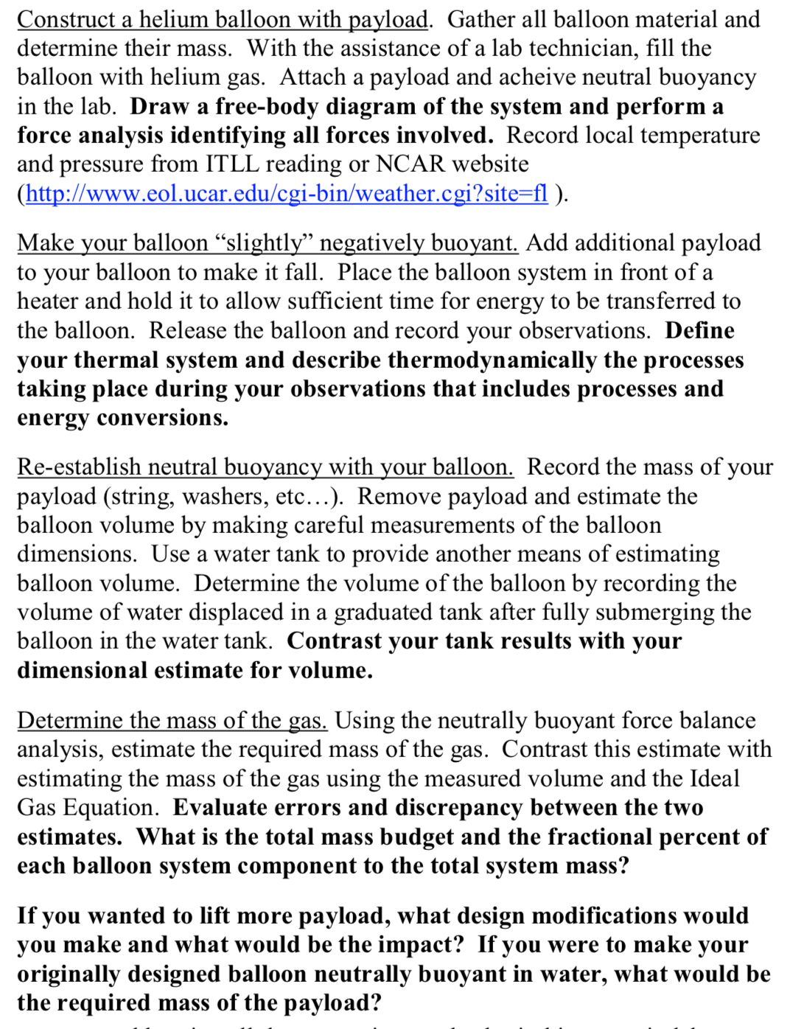
Prelab Tasks
Nation-wide He shortage
Reuse balloons
Record empty mass on a sticky note, place on your balloon after lab.
WATER TANK IS LAST!
Make sure to relate the ‘prelab’ to your design.
This is valuable for senior projects and beyond.

Slide 14
Design Lab Week 3-Week 4
Peer evaluations
Motivation
Logistics
Presentation sign up? or random?
Presentation Rubric (next slide)
Customer clarifications
Minimum requirements:
500 kg payload
Maintain 35 Km altitude within 800 meters (+/- 800 m)
24 hr duration (You pick the time of day to ’start’ mission)
Cost: Helium ($58/125L), Mylar ($40/kg)
Additional capabilities (proposal/interesting/fun)
Experimental/futuristic techniques
Longevity, altitude control, etc.
“We can do what you want”
But if you give us ___ we can do THIS!!

Slide 15
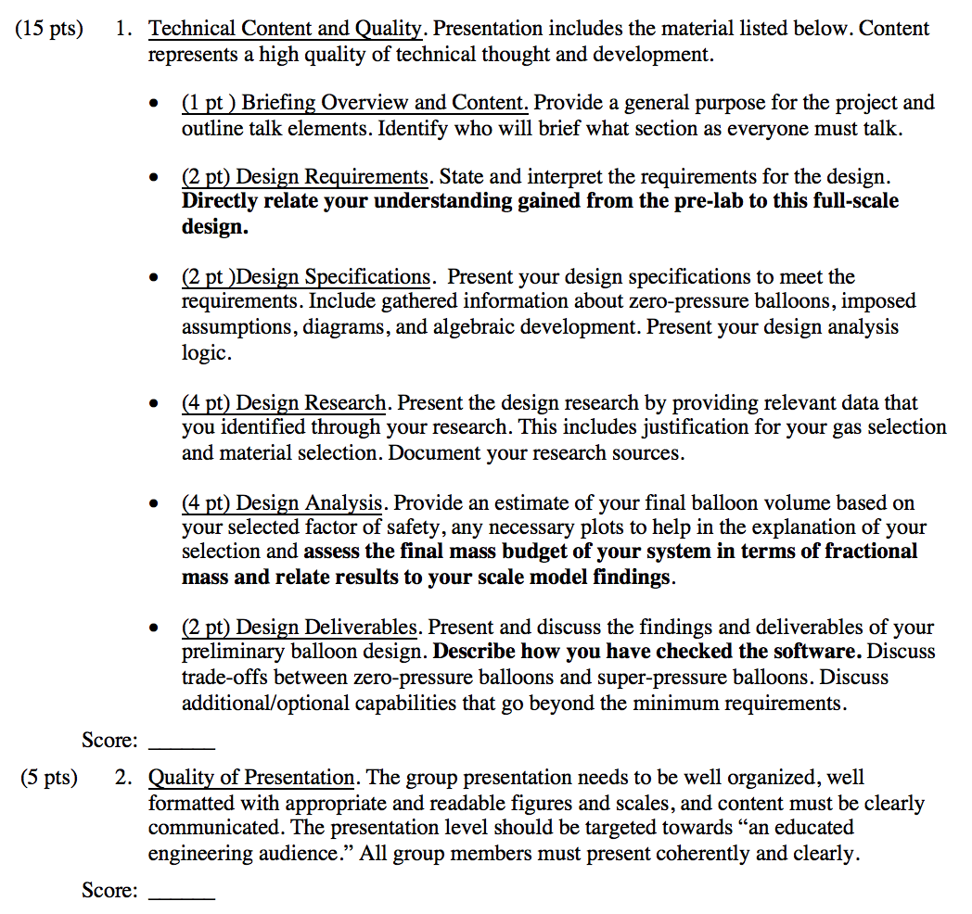
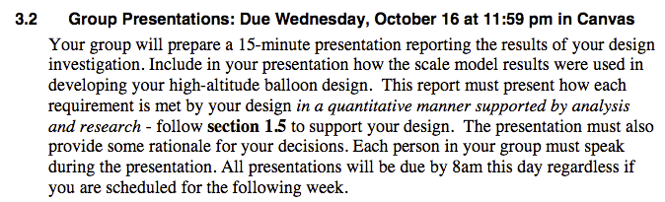
Presentation Rubric

